Slide 1
Market understanding of Sales on Amazon by Category
Zixing (Cecile) Wang

Slide 2
Project Blueprint
Define
The target of the project: to gain understanding of the relationship between different product parameters and between categories, so to understand the market and predict the market potential of a product.
Measure
Extract product data from the Amazon webpage
Analyze
Find the relationship of rankings in general category vs. rankings in sub-category
Improve
Control
Clean and transform the data
Visualize and get descriptive statistical parameters
Find the relationship of Sales vs. Ranking in a category
Find the most promising market for the product
Keep on searching for a better market
Find the marketing potential of a product in a category

Slide 3
The Data Analysis Process - Functions
Data Preparation
x_ray_clean
Data Understanding
Data Analysis Pipeline
Modeling
For ranking/ranking relationship: one_ele_ploy, exp
For sales/ranking relationship: inv_one_ele_poly, normal distribution, Lorentz distribution, Voigt, Moffat, Sersic 1D model
Evaluation
Deployment
Feedback
Parameters include: Title, Fulfillment, Price, Sales, Revenue, BSR, Review Count,
Review Velocity, Dimensions, Weight, Size Tier, Images Number and Date Created on Amazon
cat_sales
cat_ranking
prod_in_cat

Slide 4
Data Preparation
Columns:
'Title’,
'Category’,
'Fulfillment ‘,
‘Price’,
'FBA fee’,
'Sales’,
'Revenue’,
'BSR’,
'Rating’,
'Review Count’,
'Review Velocity’,
'Dimensions’,
'Weight’,
'Size Tier’,
'Images’,
'Listing Creation Date'
We look at earrings category:
Clothing, Shoes, and Jewelry
Jewelry
Earrings
Drop & Dangle Earrings
Keywords: Asymetrical Star Earrings
Keywords: Moon Star Earrings

Slide 5
Data Understanding
Graphic Output
Data output
Horizontal bar chart of keywords in top 5, 10, 50 ,100
Pie chart of categories in top 5, 10, 50 ,100
Histogram of price in all,
Ratings histogram in top 10, 50, 100 + scatter plot
Review count histogram for all + scatter plot
Review velocity -> review rate = sales/velocity scatter plot + histogram
Dimensions -> volume histogram all + scatter plot
Size Tier pie chart in all
Weight histogram in all
Image number histogram in all
Listing Creating Date -> Date on Amazon, histogram in top 10, 50, 100 + scatter plot
Dataframe of keywords occurance in top 5, 10, 50, 100
Price average, stdev, min, max
Ratings average, stdev, min, max in top 5, 10, 50, 100
Volume average, stdev, min, max
Weight average, stdev, min, max
Size Tier change to numerical
Date on Amazon average, stdev, min, max in top 10, 50, 100 + scatter plot

Slide 6
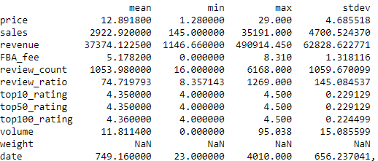
Data Understanding – top 100 Earrings
From data_analysis_pipeline:
The standard deviation of the earrings price is 36% of the average price, meaning a good price range for the products
The top 100 earrings have an average of more than 1000 reviews, which is pretty high.
Generally, around 74 sales will generate a review
The ratings are all between 4 and 5, meaning good review is the key to good sales.
The average time for the top sales product are around 2 years. With some as low as a month and some as high as more than 10 years.
Even though the top 1 sales a lot and makes a lot of revenue, the #100 already not make much at $1146/month.

Slide 7
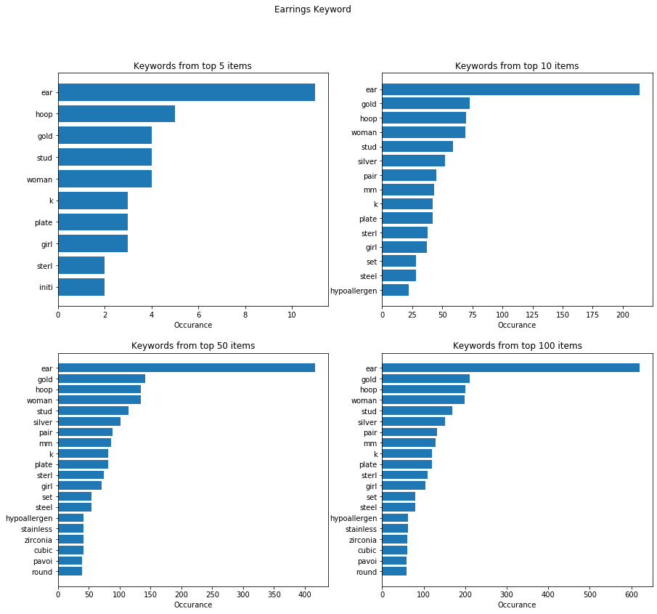
Earrings Keywords
Top keywords used by the top sellers:
Gold
Hoop
Woman
Stud
Silver
Pair
Mm
K (14k, etc)
Plate
Sterling
Girl
Set
Steel
Hypoallergen
Zieconia
Stainless
Cubic
Top sellers share similar keywords.

Slide 8
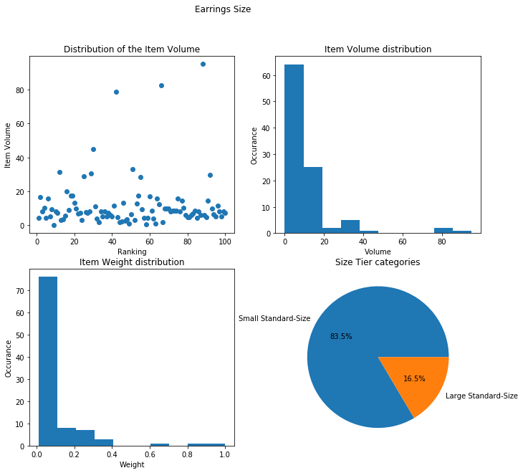
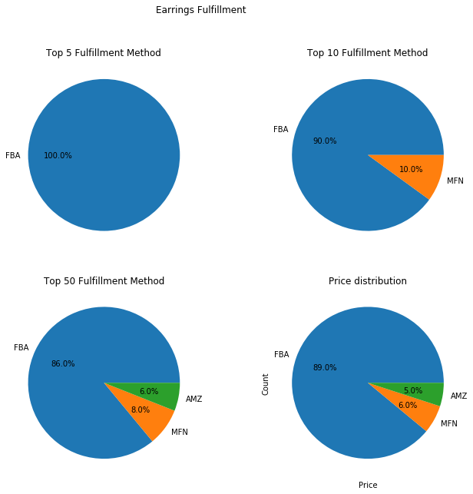
Earrings Fulfillment
FBA is the most promising fulfillment methods in the earrings category.
Most items are less than 20 in³, are most of them are small.

Slide 9
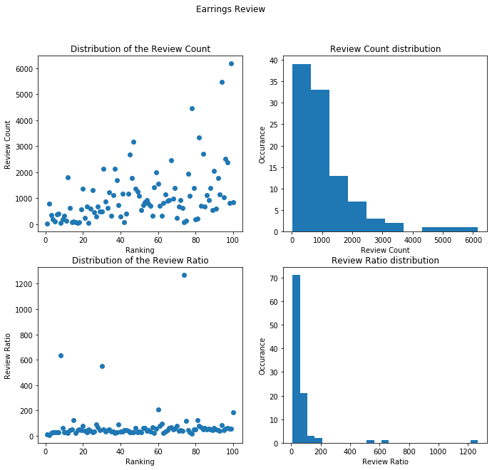
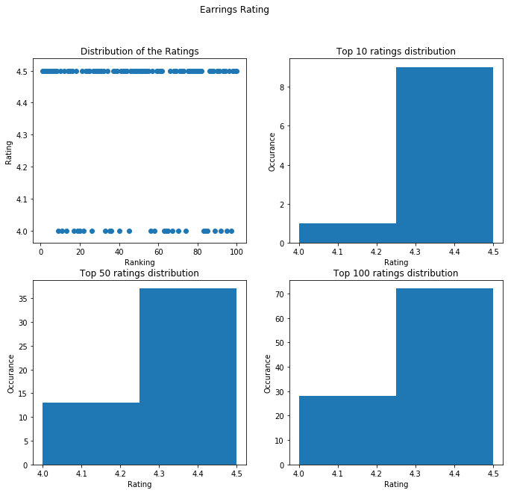
Earrings Ratings and Reviews
No surprise that all top sellers have higher than 4.5 ratings.
Not necessarily the higher the seller rank, the more reviews they have. Most of them have less than 1000 reviews. They tend to get one review <100 sales.

Slide 10
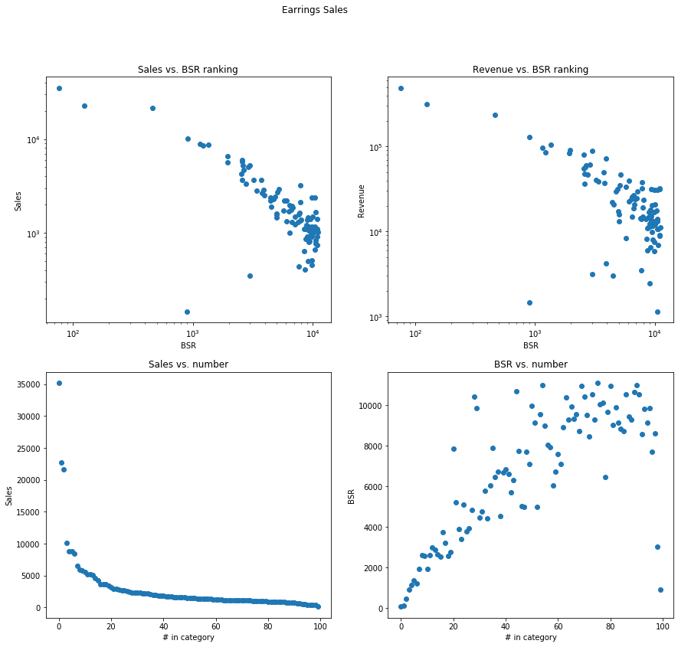
Earrings Sales
Only the top 3 sales more than 10000/month, making >100,000 /month in revenue.
The log-log plot of sales vs. BSR looks like a straight line.

Slide 11
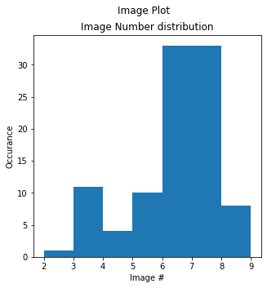
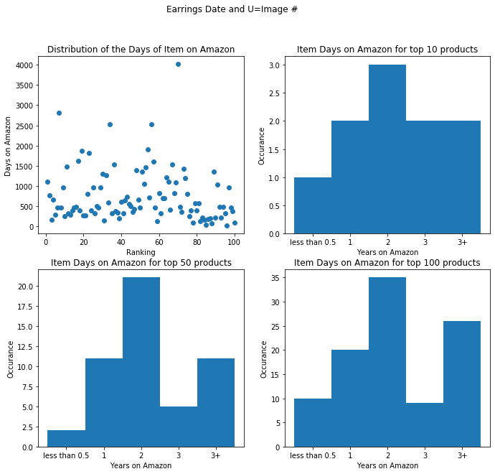
Earrings Images and Length on Amazon
Most of them have 6-8 images per item
There is not a obvious correlation between time on Amazon and sales
Most of them are 1-2 years on Amazon.

Slide 12
Sales Modelling
Plot the relationship between Sales and categorial rankings.
Use models to fit the relationship
Find the best model

Slide 13
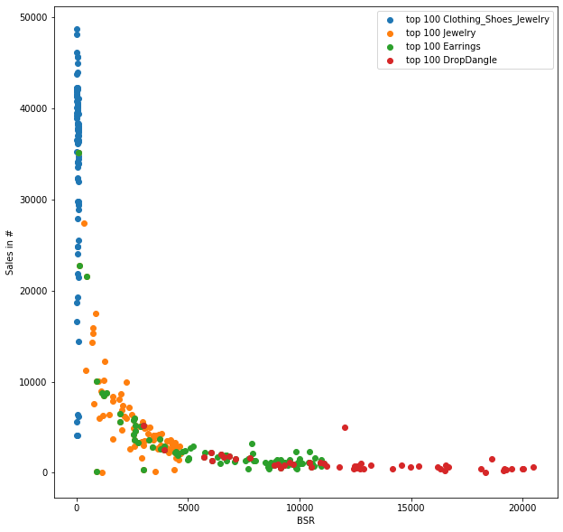
The Sales vs. BSR from all general and sub-categories

Slide 14
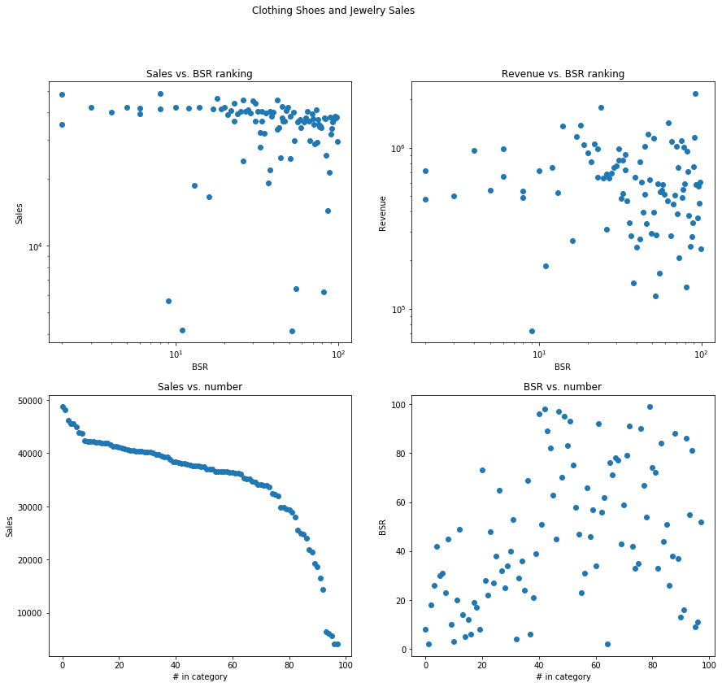
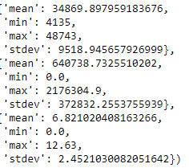
Clothing, Shoes and Jewelry Sales Plots
Sales
Revenue
FBA fee

Slide 15
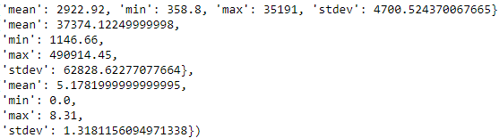
Earrings Sales Plots

Slide 16
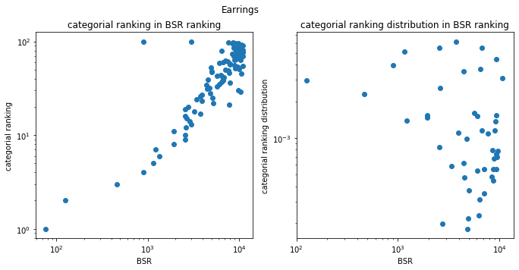
Earrings BSR vs. ranking within category
The relationship between log ranking vs. log BSR is very close to linear.
For the distribution of rankings with BSR, they distribute more at higher BSR ranks, meaning earring is the less popular category within the general category.

Slide 17
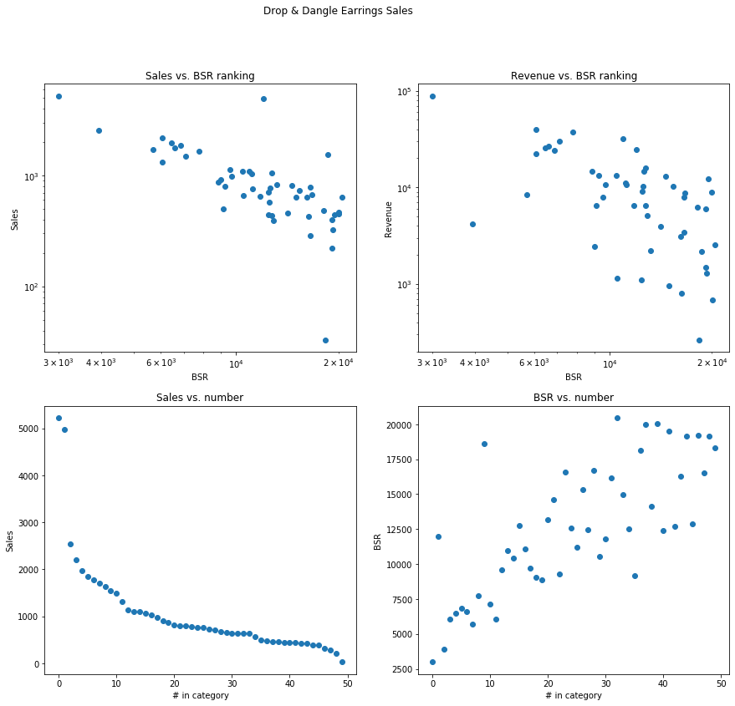
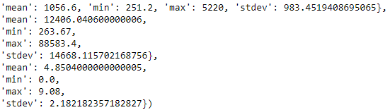
Drop & Dangle Earrings Sales Plots

Slide 18
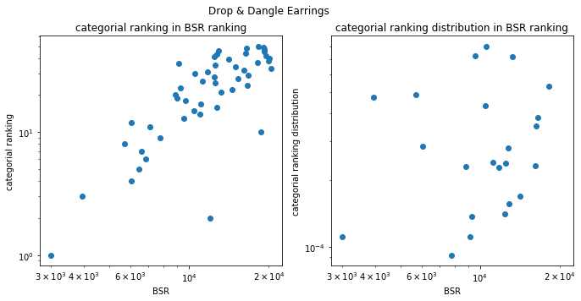
Drop & Dangle Earrings BSR vs. ranking within category

Slide 19
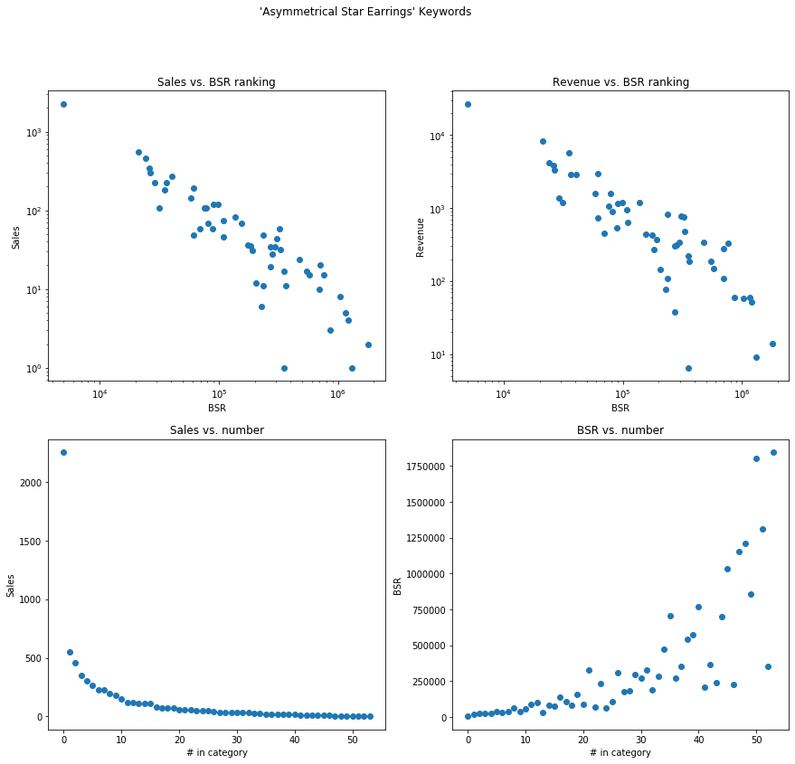
Asymmetrical Star Earrings Sales Plots

Slide 20
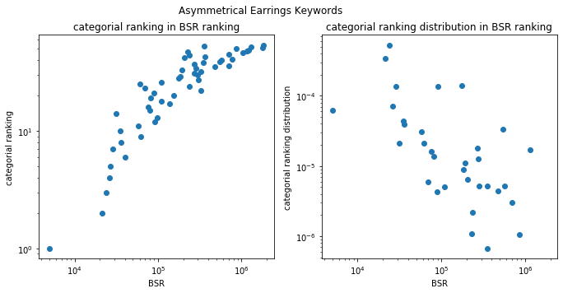
‘Asymmetrical Star Earrings’ BSR vs. ranking within category
The relationship between log ranking vs. log BSR is very close to linear.
For the distribution of rankings with BSR, they distribute more at lower BSR ranks, meaning the ‘asymmetrical star earring’ is the more popular category within the general category.

Slide 21
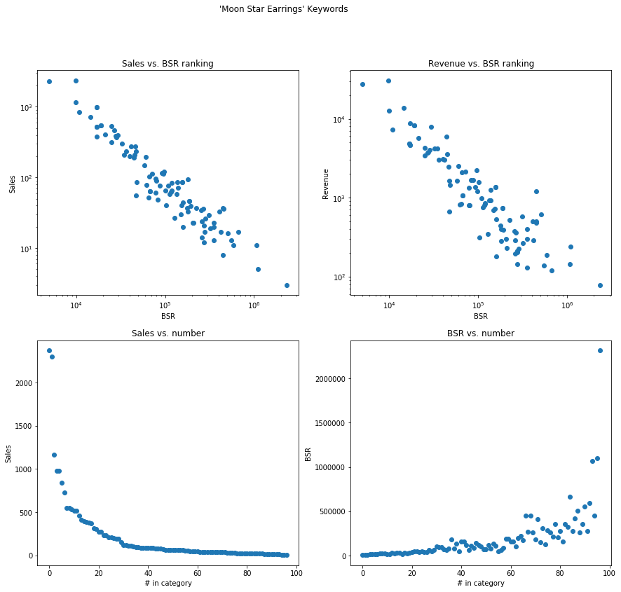
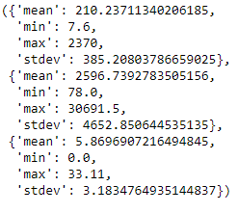
‘Moon Star Earrings’ Sales Plots
Sales
Revenue
FBA fee
The 100th item in this category only makes 7.6 sales/month, which should be a red flag.
The best seller in this category makes $2596 in revenue, which makes making a considerable profit in this category challenging.

Slide 22

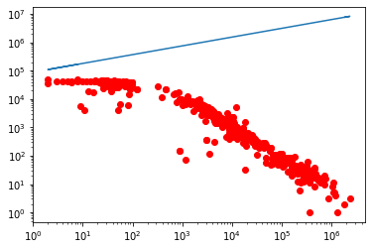
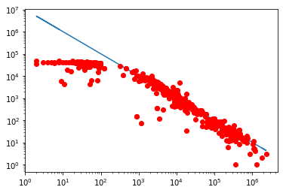
Model Fitting of Sales vs. BSR – one ele poly
Loglog plot of Sales vs. BSR. (machine fitted)
Model 1: one element polynomial
beta_1 = 87515.008397, beta_2 = 0.309465
Loglog plot of Sales vs. BSR. (manually fitted)
beta_1 = 10000000, beta_2 = 1.00
Mean absolute error: 1724833.23
Residual sum of squares (MSE): 5148258185534.31
R2-score: -25871.49
One element polynomial models gives a straight line at the log log scale. However, for a big category with large data set, the log log plot does not look straight.
A better model is needed.
Mean absolute error: 91866.54
Residual sum of squares (MSE): 175197682053.89
R2-score: -879.45

Slide 23
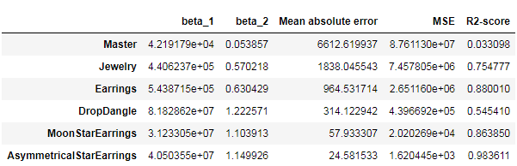
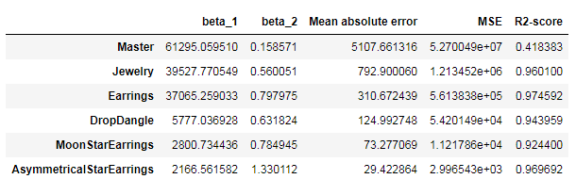
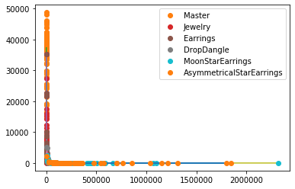
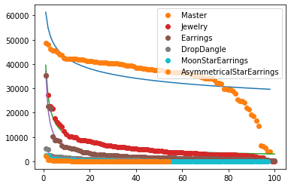
Model Fitting of Sales vs. BSR – one ele poly – sub-category
Sales vs. BSR
Sales vs. Categorial ranking
One ele poly model fitting seems to be pretty good.

Slide 24
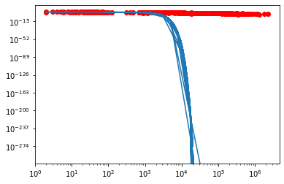
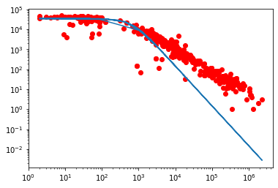
Model Fitting of Sales vs. BSR – statistical distributions
Gaussian
Lorentz
amplitude=34608.13726131,
mean=0.,
stddev=570.60401115
Mean absolute error: 2789.9680423836126
MSE: 24421280.83887043
R2-score: 0.8772712382035448
amplitude=34824.51441145,
x_0=0.,
fwhm=1307.45048268
Mean absolute error: 2341.799182415065 MSE: 21382126.716892444
R2-score: 0.8925444593240879

Slide 25


Model Fitting of Sales vs. BSR – statistical distributions
Voigt
Moffat
Mean absolute error: 10607.58333525486
MSE: 214057883.21738735
R2-score: -0.0757445169798594
x_0=0.,
amplitude_L=34809.68161519, fwhm_L=1288.59262157, fwhm_G=0.04494345
Mean absolute error: 2350.5026250298265 MSE: 21379780.778911937
R2-score: 0.8925562487984197
Sersic 1D
Mean absolute error: 2077.721154045638 MSE: 19690695.205216885
R2-score: 0.9010447217165927

Slide 26
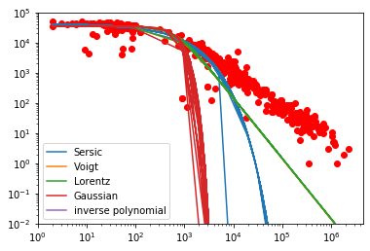
Model Fitting of Sales vs. BSR – statistical distributions - Summary
Model | Avg. R2 score | clothing, shoes, jewelry BSR R2 score
Lorentz | 0.568 | 0.893
Gaussian | 0.500 | 0.877
Inverse polynomial | 0.688 | -25871.49

Slide 27
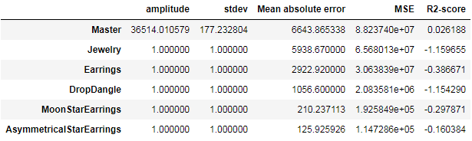
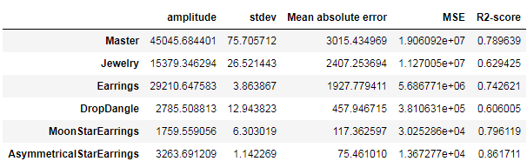
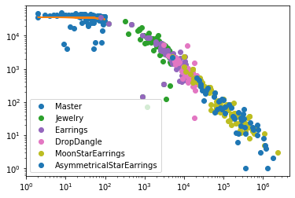
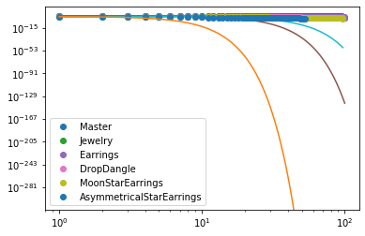
Model Fitting of Sales vs. BSR – statistical distributions – sub-category
Gaussian distribution
Sales vs. categorial ranking
Sales vs. BSR

Slide 28
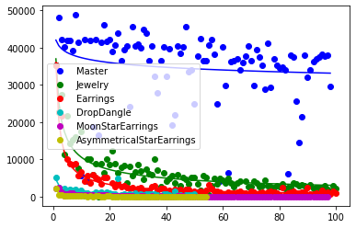
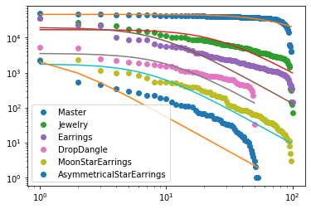
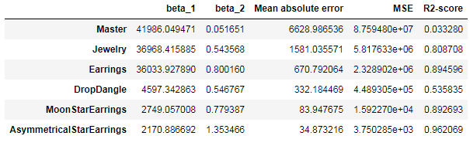
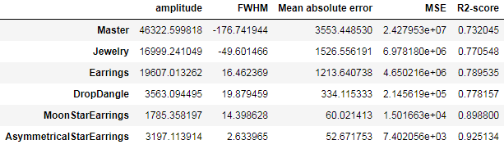
Sales vs. ranking fitting
Inverse polynomial Fitting
Lorentz Fitting

Slide 29
Sales vs. ranking fitting summary
Large data in a general category
Sub-categorial fitting average
Lorentz fit of the clothing, shoes, jewelry BSR R2 score: 0.8925444593240879
Gaussian fit of the clothing, shoes, jewelry BSR R2 score: 0.8772712382035448
Inverse poly fit of the clothing, shoes, jewelry BSR R2 score -25871.49
Lorentz fit R2 score: 0.8157029639466388
Gaussian fit R2 score: 0.7375867449836967
Inv poly fit R2 score: 0.8651878980321333
Conclusion:
In general, Lorentz is the more suitable for a big general category, while inverse polynomial fitting is more suitable for modeling a sub-category.

Slide 30
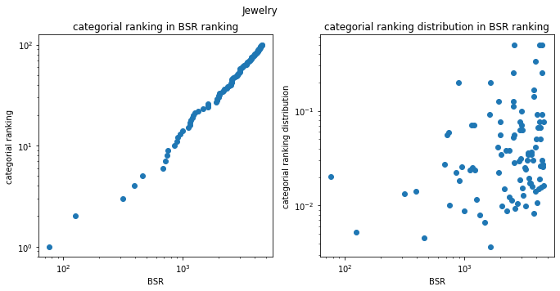
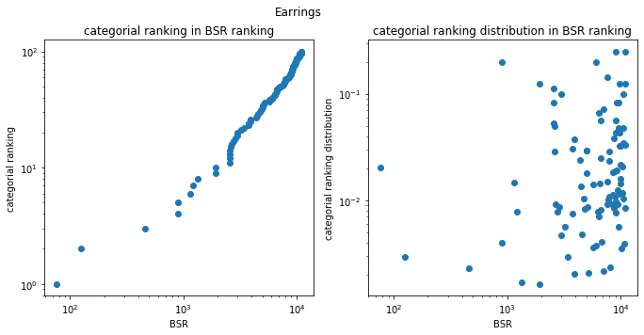
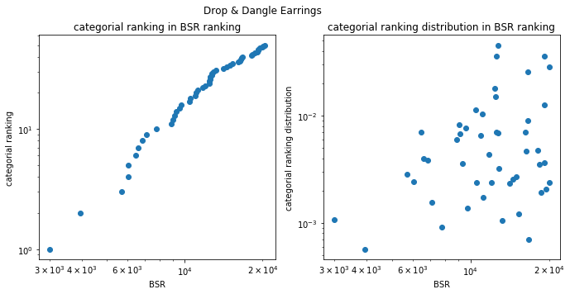
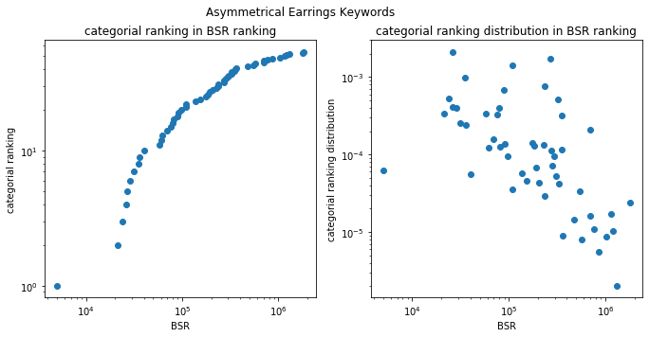
Repeated: Categorial ranking vs. BSR

Slide 31
Model Fitting of Rankings – statistical distributions – sub-category
If the sales vs. ranking can be treated as inverse polynomial within a category, then the rankings relationship between categories with the same sales can be treated as polynomial function.

Slide 32
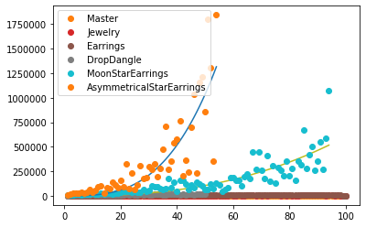
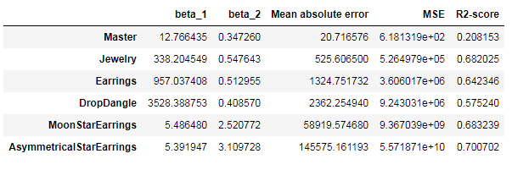
Ranking model fitting: Model 1: one element polynomial
Fitting BSR vs. categorial rankings data using one element polynomial seems to be decent in the sub-categories.

Slide 33
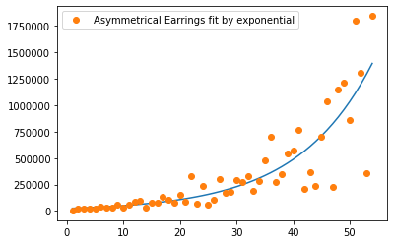
Ranking model fitting: Model 2: exponential
Keywords category: clothing, shoes and jewelry
Other categories
'beta_1': 42.64207486492577,
'beta_2': 0.07513857608405146,
'beta_3': 84.35861871018314,
'Mean absolute error': 133471.2849552475,
'MSE': 53206894449.69619,
'R2-score': 0.7141947262124682}
Fitting unsuccessful.
Impossible to fit with exponential. Since the derivative of such function is concaving up. However, in our scenario, sometimes the growth rate is increasing, and sometimes the growth rate is decreasing.

Slide 34
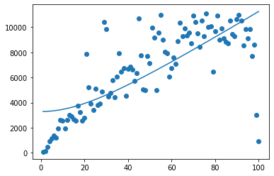
Ranking model fitting: Model 3: Lorentz distribution
Earrings category
‘Asymmetrical Star Earrings’ keywords category
Unable to fit

Slide 35
Ranks model fitting conclusion:
The best model for ranking relationship fitting is single element polynomial curve.

Slide 36
Data Evaluation
Categorial data
Category – category relationship
Top 10 sales
Top 10 revenue
Top 10 sales percentage
Top 50 sales
Top 50 revenue
Top 50 sales percentage
Top 100 sales
Top 100 revenue
Top 100 sales percentage
Top 10 ranking top n in the other category
Top 10 count for percentage of sales in other category
Top 50 ranking top n in the other category
Top 50 count for percentage of sales in other category
Top 100 ranking top n in the other category
Top 100 count for percentage of sales in other category

Slide 37
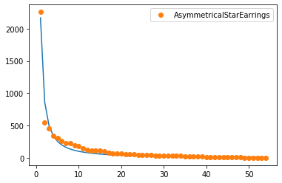
Data Evaluation: Sales prediction in keywords ‘Asymmetrical Star Earrings’
Model used: inv_one_ele_poly
'beta_1': 2166.5615816112754,
'beta_2': 1.33011183194415,
'Mean absolute error': 29.422863,
'MSE': 2996.543196120532,
'R2-score': 0.9696924616175774
Top total sales and revenue is decently correct, with 10% or less error.
The sales number at exact ranking position is not very accurate.

Slide 38
Data Evaluation: category relationship Earrings & Drop Dangle Earrings
The sales of drop & dangle earrings does not seem to take a large portion of the sales in the earrings category.
The more lower-ranking products included, the higher the percentage becomes, meaning drop & dangle earrings are more at the lower sales range of the earrings category.

Slide 39
Data Evaluation: category relationship Earrings & Asymmetrical Star Earrings
'10th_ranking': 5, ←10th ranking can be not very accurate, since the higher the number, the higher the error.
'top_10_sales_perc': 2.9362341866147648,
'50th_ranking': 1094861.8877267775,
'top_50_sales_perc': 0.023051081101337433,
'100th_ranking': 214077604.31102115,
'top_100_sales_perc': 0.023055689906673116
This time, the prediction does not seem to be accurate as it is unrealistic for the 100th ranking product in asymmetrical star earrings rank so low in the earrings category. More error is introduced when using keyword category to find the categorial relationship.

Slide 40
Data Evaluation: category relationship Earrings & Moon Star Earrings
'10th_ranking': 1,
'top_10_sales_perc': 9.0,
'50th_ranking': 4062.2017095325086,
'top_50_sales_perc': 0.30365643318843544,
'100th_ranking': 292440.3934360021,
'top_100_sales_perc': 0.061302045978840265
Estimated errors:
'10th_ranking': ,
'top_10_sales_perc':,
'50th_ranking': 4062.2017095325086,
'top_50_sales_perc': 0.30365643318843544,
'100th_ranking': 292440.3934360021,
'top_100_sales_perc': 0.061302045978840265
The prediction is better than the previous try, but still need improvement.

Slide 41
Deployment: testing a product in a category
a random earring in the products with keywords ‘Moon Star Earrings’
a random earring in the products with keywords ‘Asymmetrical Star Earrings’
Ranking calculated by BSR is more accurate than the ranking calculated by sales.

Slide 42
Deployment: testing a product in a category
a random earring in the products with keywords ‘Drop & Dangle Earrings’
ranking_by_BSR: 845947
ranking_by_Sales: 27760
Percentile: top 3%

Slide 43
Conclusions and Future work:
Conclusions:
The sales. Vs. ranking modelling should be treated in two cases:
Case 1: large number of data in a general group: Lorentz model (r2 = 0.89)
Case 2: small number of data in a sub-group: inverse single element polynomial (R2 = 0.87)
The rankings vs. BSR can be modelled with single element polynomial function (R2 = 0.65)
From the above models, we can estimate
The distribution of sales within a category (Error > 3%)
The relationship between two category (Error > 40%)
If we know the ranking or the sales of a product, we can estimate the other variable. (Error > 10%)
Future work:
need to redo the category-category relationship.
Current algorithm: get ranking vs. BSR relationship from the two categories and then associate the rankings from the category by BSR. This is worse because the rankings vs. BSR is more rough than sales. Vs Ranking
New algorithm: get the sales number of one category and predict the ranking of another category based on sales.

